Slide 1
IUGO – E-learning platform
Created by:
Alexandru-Adonis Neagu -18017575
Oana Diana Prahoveanu - 18016761
Sebastian Visianu
Nicolay Nenchev
Mario Nemecek

Slide 2
System’s features and subsystems:
1.Facial recognition
2.Functional backend for the system
3. Frontend, chat feature and voice/video call feature
4.Gradebook feature
5.Schadule feature

Slide 3
What the system offers:
The first interaction of the user with the platform happens on the homepage, where a short motto is displayed along with the login and register button.
To benefit from the platform functionalities the user must complete the registration form.
Regarding the login feature, the user has two options, the classic login which requires the email and password or the facial recognition login.
After the login is successfully done the user can access the module list, the chat feature, its profile, the grade book feature and the schedule.
By accessing a module from the module list, the user is redirected to a group chat with all the participants of the specific module.
The group chat page provides a link for joining a voice/video call meeting with all participants.

Slide 4
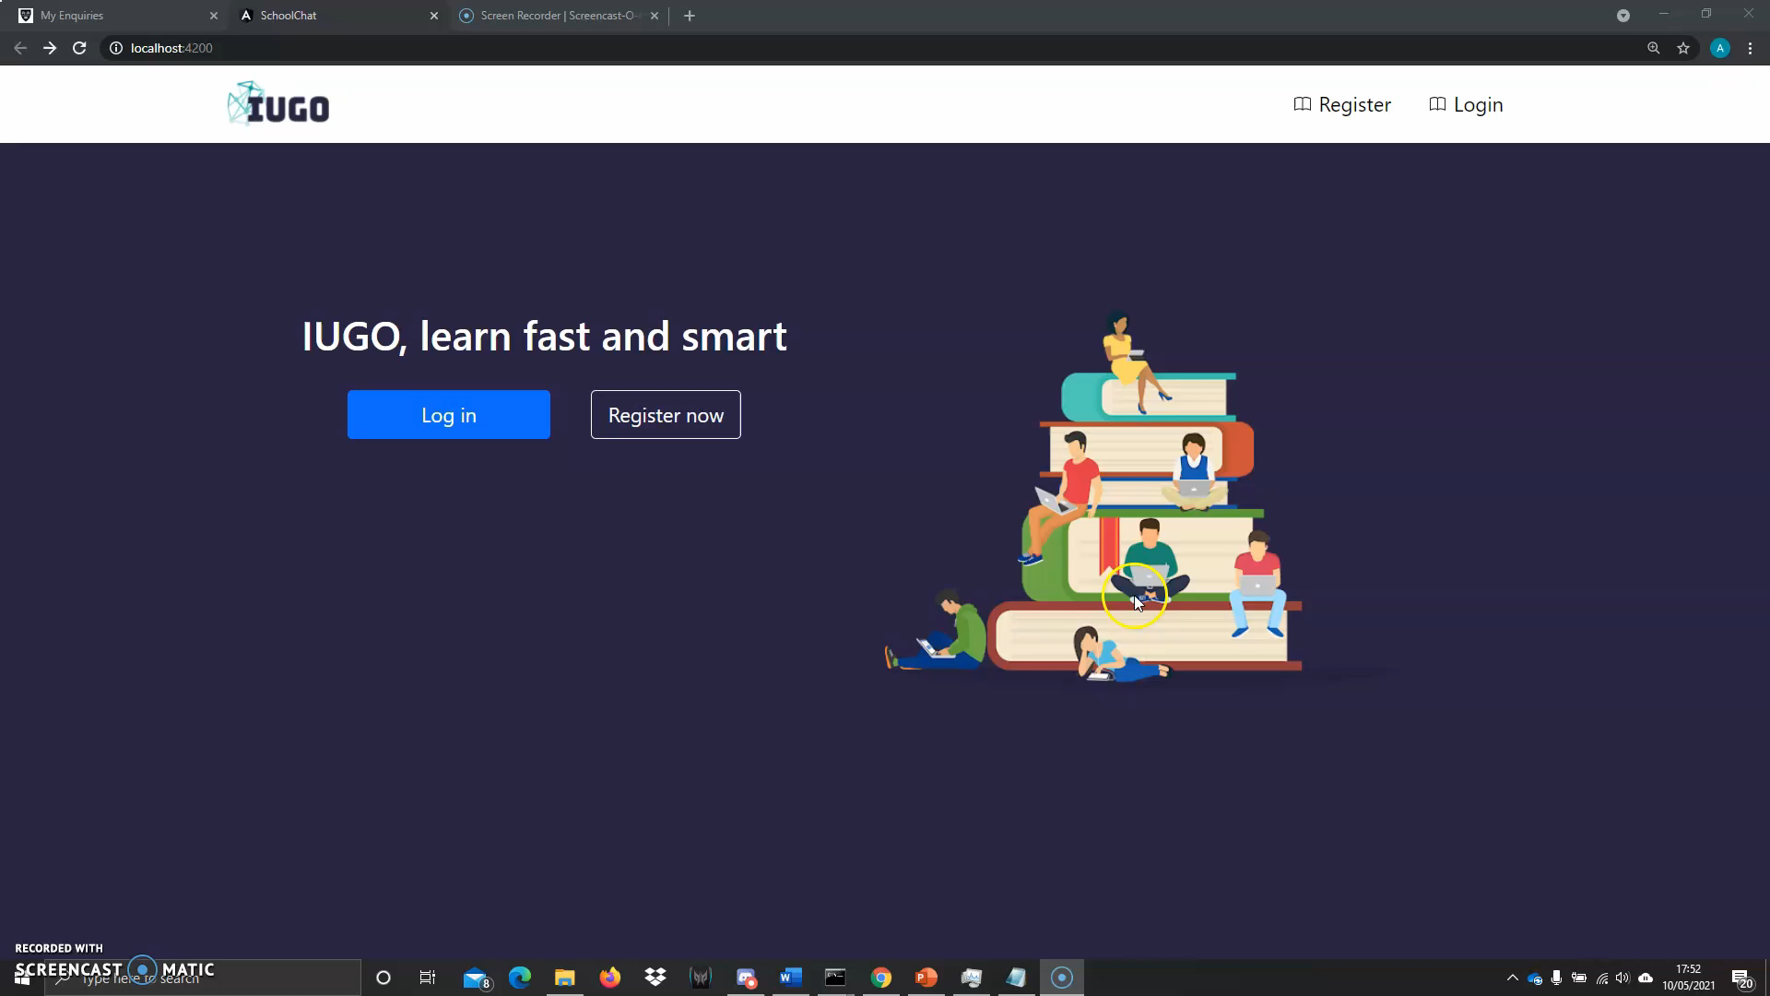
Demo presentation:

Slide 5
Frontend, chat and voice/videocall meetings
Oana Diana Prahoveanu- 18016671

Slide 6
Angular
What?
Angular is an open-source framework used to develop single-page web applications. Angular applications are built using TypeScript language, a superscript for JavaScript.
Why?
The use of TypeScript for increasing the maintainability of code, the performance score that improves as you make more complex applications.
Reusability-The component-based structure of Angular makes the components highly reusable across the app.
Compared with ReactJS, Angular is more versatile and maintainable.
Future Work
Easier maintenance thanks to decoupled components which are replaceable with better implementations

Slide 7
Socket.io
What?
Socket.IO is a library that uses the WebSocket protocol to enable real-time, bidirectional and event-based communication between the browser and the server.
WebSocket is the internet protocol that allows for full duplex communication between a server and clients.
It has two parts: a client-side library that runs in the browser, and a server-side library for Node.
Why?
Future Work
Useful for further improvements of the system (ex. Notification feature)

Slide 8
Meet.JITSI
What?
Jitsi Meet is a free encrypted video conferencing JavaScript software.
Why?
Numerous features, namely: chat space which can be used by all participants during the call, rise-hand option, share screen feature for presentation and documents, for extra security a password to join the meeting can be added.
Jitsi Meet users don’t need to create an account to join a call.
Know as a software which can be trusted, no cyber security issues have been reported.
Future Work
Could be changed due to its limitations, no more than 75 users can join the meeting.
It’s a safe engine but its security level its improved if the system his hosted on a trusted saver.

Slide 9
Frontend: Design choices
Interactive design choices : The stakeholder played a key role during the development process
Stakeholder chose the colour scheme, logo design, the orientation of the lists, the aspect of the chat.
Instinctive navigation trough system features, based on the feedback received from the stakeholders
Clear design to avoid loaded pages that would lose user’s interest and implication into the activities carried out within the classes.

Slide 10

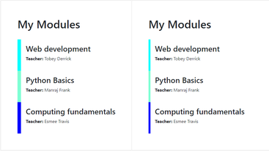
Question regarding the design

Slide 11
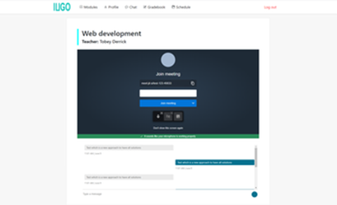
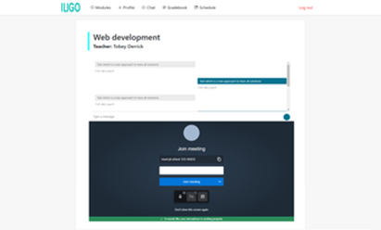

Slide 12
Facial recognition subsystem
Alexandru-Adonis Neagu - 18017575

Slide 13
Why Facial Recognition?
Biometrics based system has gained much importance in the security area. Facial recognition proved to be the most reliable way of authentication. This is because is the most economic and easy solution to identify individuals.
This system was developed as a replacement for old ways such as passwords, keys, PINs, cards etc. The most common issues regarding the conventional security methods are the possibility to be forgotten or lost.
When a username or password is forgotten the user has to go through a whole process to recover them which is time-consuming

Slide 14
How does facial recognition work?
The camera is turned on and a short video is recorded.
Each frame of the video pass-through Haar Cascade model that detects the face.
The face is cropped out of the original picture.
The face is fed to the face recognition model and return the name of the user detected.
There are twenty predictions for each frame of the video. A list with the number of the names predicted is created.
The class with the biggest prediction rate is returned and sent to the backend of the system.

Slide 15
How was the dataset created?
The dataset was created by using haar cascade model.
The pictures for each class were created by cropping the faces out of each frame of the video.
There are for classes: Alexandru, Sebastian, Diana and Unknown.
The Unknown class was created by adding the pictures with faces of different people using an open-source dataset from the internet.

Slide 16
How was the model build?
1. Getting the pictures and adding image pre-processing
2.Choosing and importing a pre-trained model
3.Fine-tuning the imported model
4.Evaluate the base model
5.Tune the parameters
6.Use the model for predictions

Slide 17
Why did I choose TensorFlow as a framework?
It gives you access to high-level APIs like Keras which provides essential abstractions and building blocks for developing and shipping machine learning solutions with high iteration velocity.
It allows GPU support which reduce the computational time
Provides excellent documentation and community support

